Slide 1
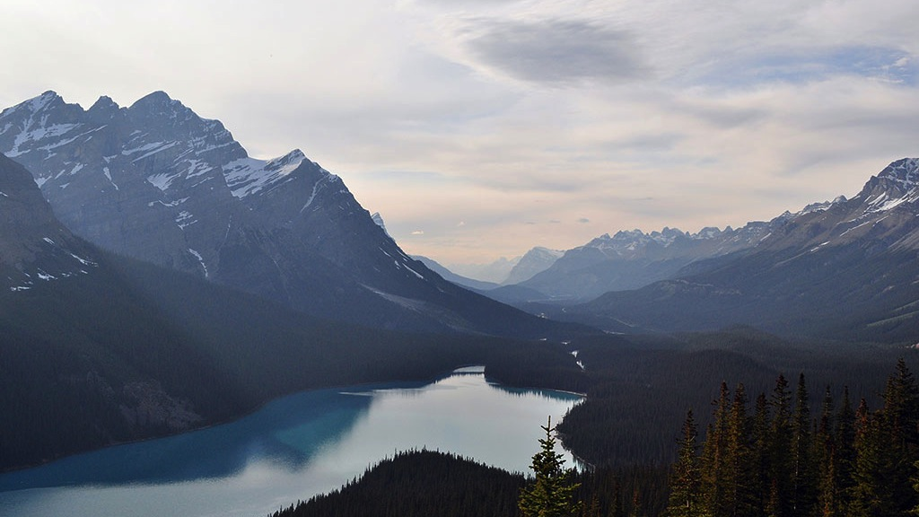

AngularJS.
Routing
NADZEYA SHEDAVA
OCTOBER 19, 2015

Slide 2
COURSE AGENDA
1. INTRO
Angular features
Bootstrap a project
2. CONTROLLERS & MARKUP
Organize code in controllers
Use build-in directives to control view
3. SERVICES
More domain logic to services
Facilitate single-responsibility principle
4. DIRECTIVES
Create own custom elements
Observe changes
Handle events
5. ROUTING
Create true SPA with routing
Use built-in functionality of Angular routing
6. SECURITY
Security scenarios
Work with access tokens
React to 401
Cross-site scripting attacks
Correct bind HTML
7. DEBUGGING & DIAGNOSTICS
Diagnostic and debugging
8. ANGULAR UI
Search for ready solutions
9. FORMS
Enjoy two-way binding
Validate your user input
Show messages
10. TESTING
Test controllers, services and directives
Do full end-to-end testing

Slide 3
MODULE AGENDA
1
Old time
2
Built-in routing
3
UI Router
4
Web crawlers

Slide 4
OLD TIME
http://www2.warnerbros.com/spacejam/movie/cmp/junior/gamesframes.html

Slide 5
ROUTING
SPA
Create and navigate routes
Access route parameters
Handle slow loading pages
HTML5 routing
Inspect URL parts

Slide 6
NGROUTE
$routeProvider
$routeParams
$route
ngView

Slide 7
HTML5 MODE
$locationProvider.html5Mode(true)

Slide 8
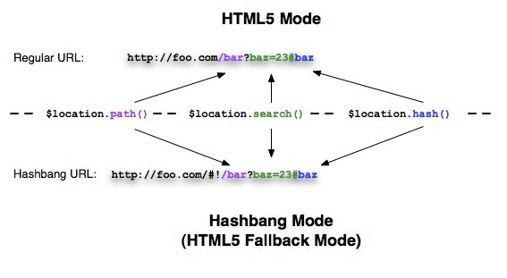
$LOCATION
absUrl
protocol / host / port
url
path / search / hash
replace
state (HTML5)
events:
$locationChangeStart
$locationChangeSuccess

Slide 9
DEMO
{{ ngRoute module }}

Slide 10
UI ROUTER
Nested views - http://plnkr.co/edit/u18KQc?p=preview
Multiple named views - http://plnkr.co/edit/SDOcGS?p=preview

Slide 11
UI ROUTER
$stateProvider
$urlRouterProvider
uiView
uiSref

Slide 12
DEMO
{{ UI Router }}

Slide 13
WEB CRAWLERS
Earlier: Turn off you JS to see how a site looks to a crawler
Now: Don’t worry about it http://googlewebmastercentral.blogspot.com.by/2015/10/deprecating-our-ajax-crawling-scheme.html

Slide 14
WEB CRAWLERS
EARLIER
NOW
Turn off you JS to see how a site looks to a crawler
Don’t worry about that http://googlewebmastercentral.blogspot.com.by/2015/10/deprecating-our-ajax-crawling-scheme.html

Slide 15
Q & A

Slide 16
Thank you
for your attention :)

